Slide 1
Chapter Seven
Graphs

Slide 2
Classification of Data Structures
Linear Data Structure
Arrays
Linked Lists
Stacks
Queues
Non-Linear Data Structure
Trees
Graphs

Slide 3
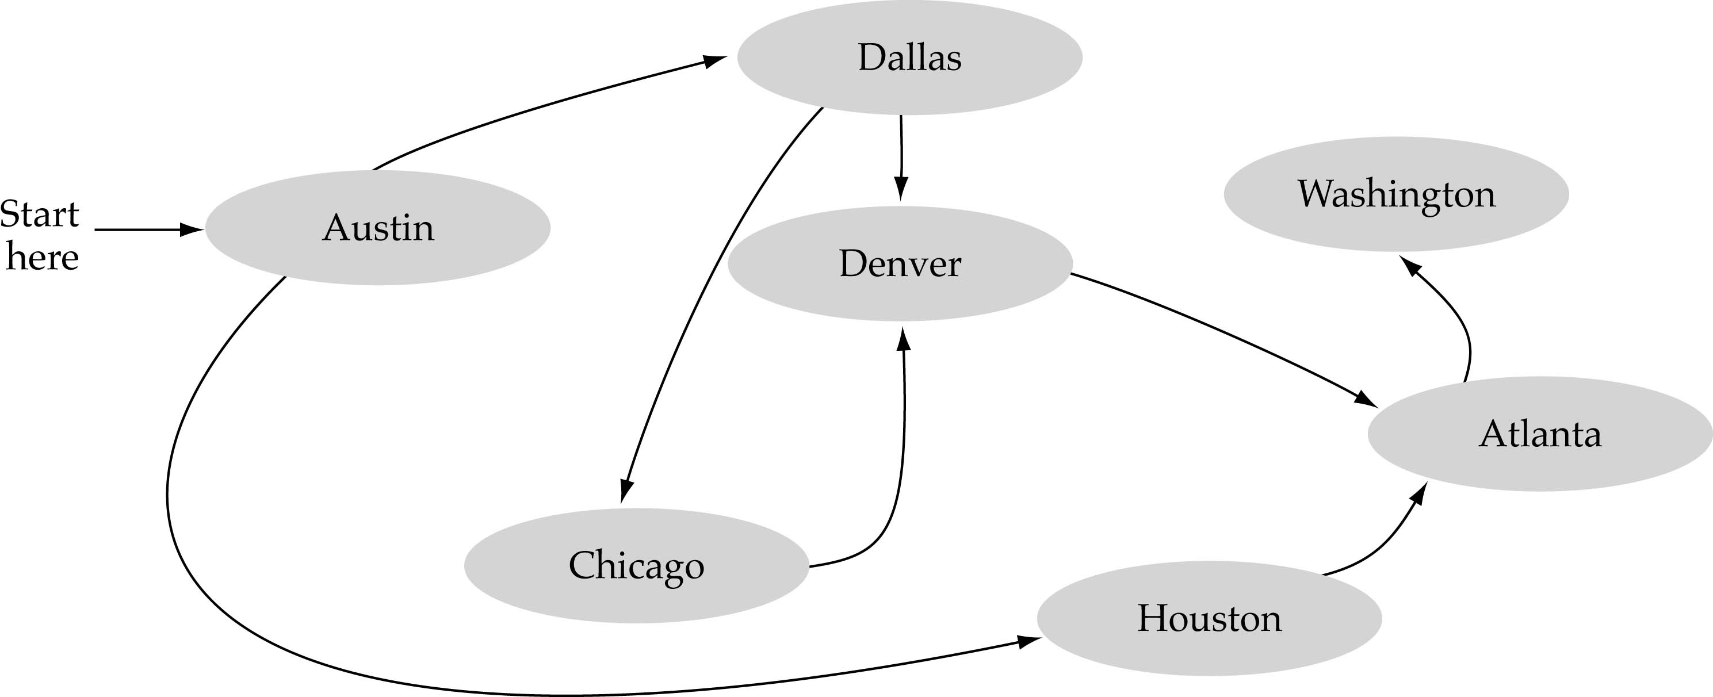
What is a Graph?
A data structure that consists of a set of nodes (vertices) and a set of edges (arcs) that relate the nodes to each other.
The set of edges describes relationships among the vertices.

Slide 4

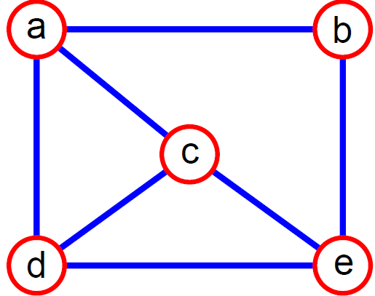
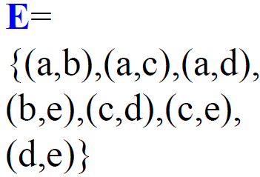
Formal Definition of Graphs
A graph G is defined as follows:
G=(V,E)
V(G): a finite, nonempty set of vertices
E(G): a set of edges (pairs of vertices)
An edge e = (u,v) is a pair of vertices
Example:

Slide 5
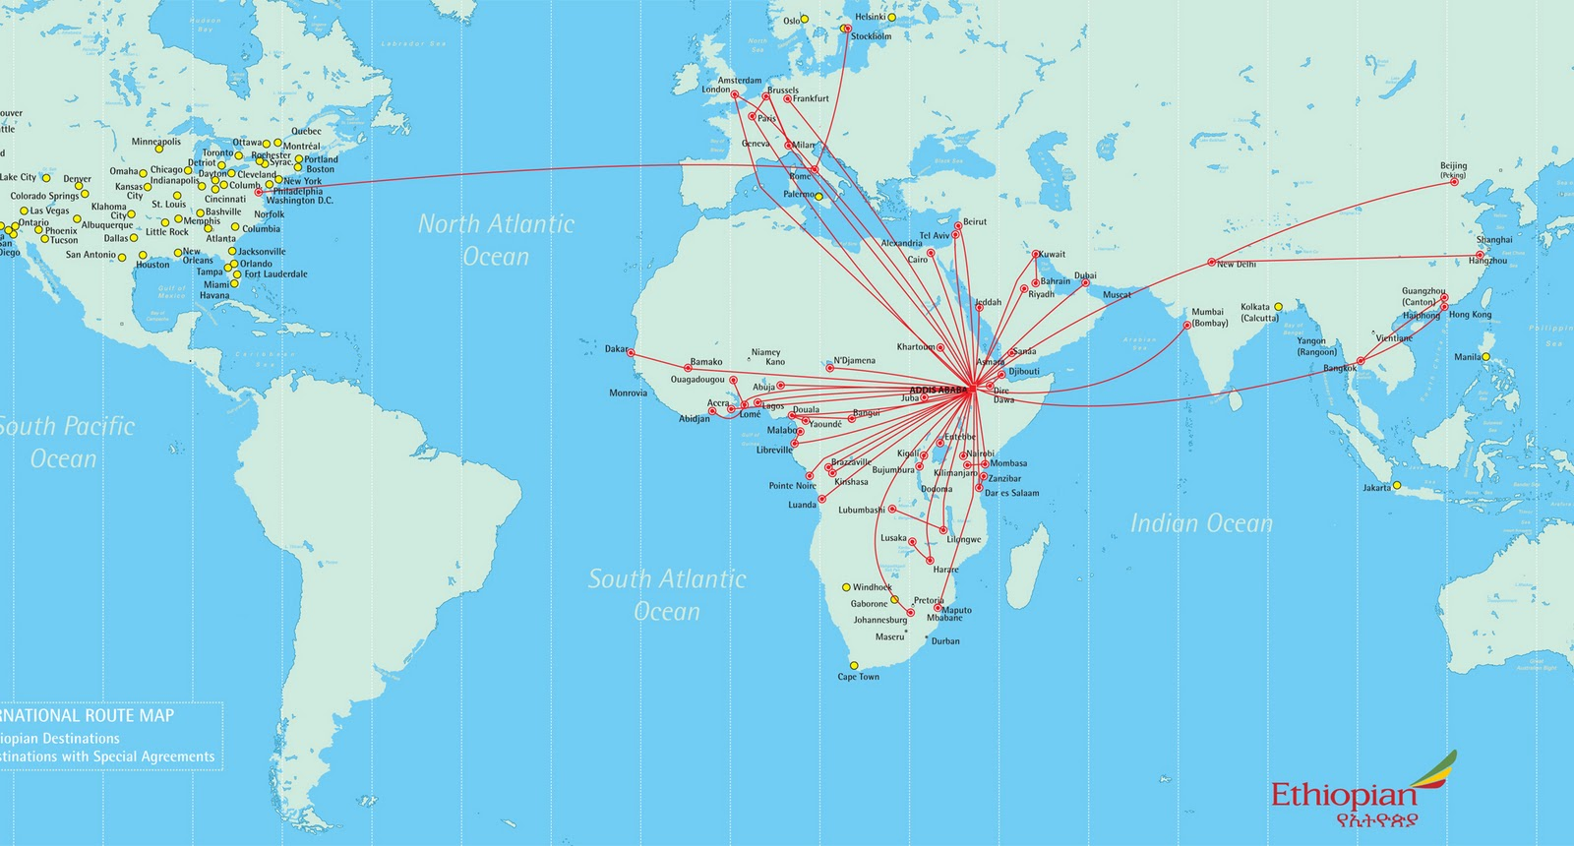
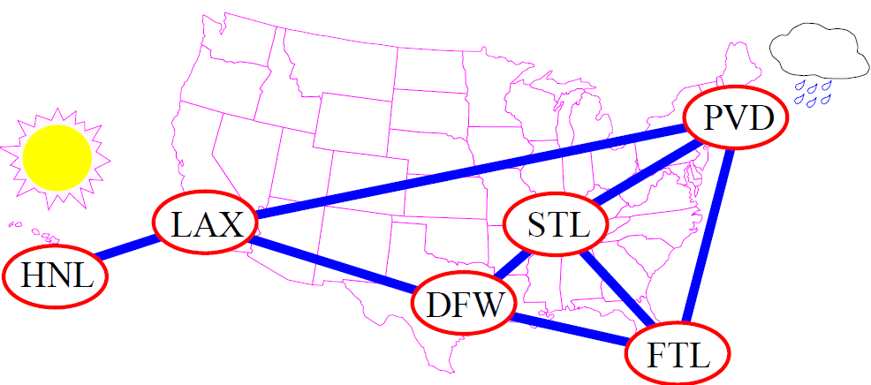
Applications of Graphs
Airline Routes

Slide 6
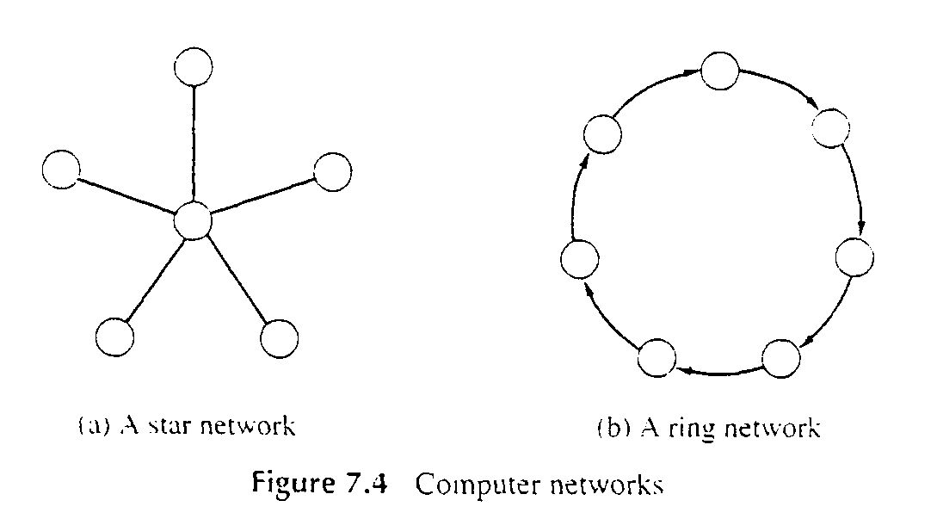
Applications of Graphs (cont.)
Computer Networks

Slide 7
Formal Definition of Graphs…..
A simple graph G=(V, E) consists of a nonempty set of vertices V and a (possibly empty) set of edges E.
Figure a-c shows examples of simple graphs.
Note that there must be at least one vertex be there need not be any edges, as in Figure a.
Also note that a graph may consist of two unconnected sets of nodes, as in Figure b.
A complete graph is one in which every node is connected to every other node (Figure d).
A multi-graph is a graph in which two nodes can be joined by multiple edges (Figure e)
A pseudo - graph is a graph in which loops can occur, i.e. a node can be joined to itself (Figure f).

Slide 8
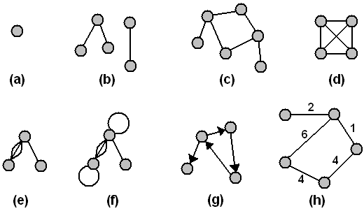
Formal Definition of Graphs…..
A directed graph, or digraph, is one in which the edges have a direction. Finally, a weighted graph is one in which each edge has an associated value, or weight.
Examples of graphs: (a-c) simple graphs; (d) a complete graph; (e) a multigraph; (f) a pseudograph; (g) a digraph; (h) a weighted graph

Slide 9
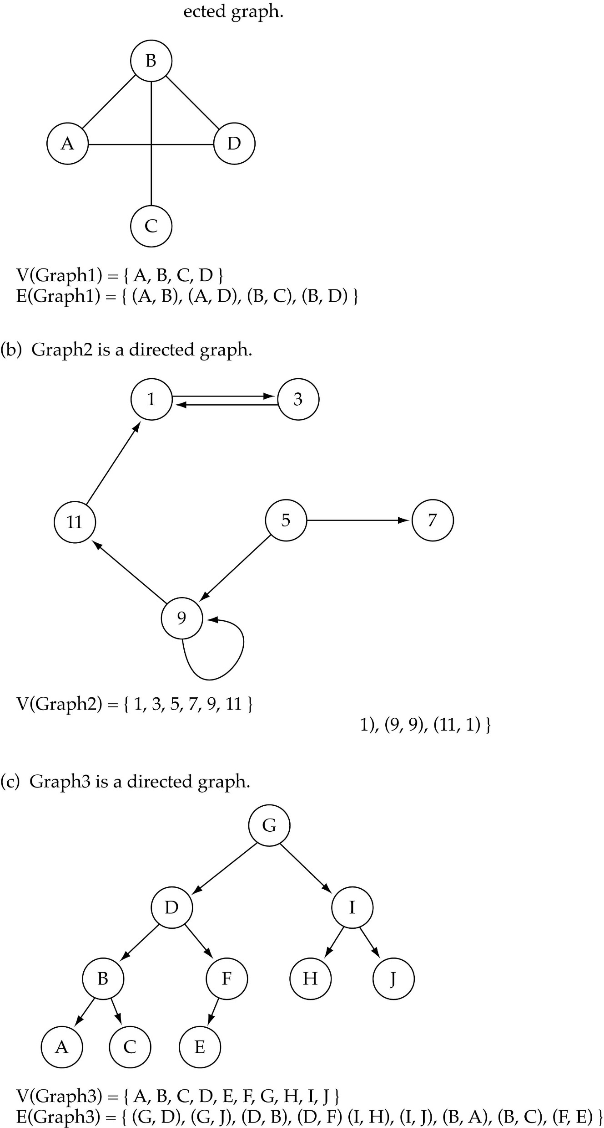
Directed vs. Undirected Graphs
When the edges in a graph have no direction, the graph is called undirected.
(a) Graph1 is undirected graph

Slide 10

Directed vs Undirected Graphs (cont.)
When the edges in a graph have a direction, the graph is called directed (or digraph).
Warning: if the graph is directed, the order of the vertices in each edge is important !!
E is a set of ordered pairs of elements of V.
E(Graph2) = {(1,3) (3,1) (5,9) (9,11) (5,7)

Slide 11
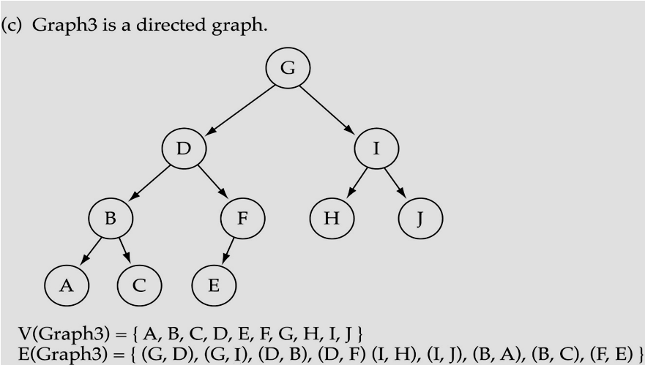
Trees vs Graphs
Trees are special cases of graphs!!

Slide 12

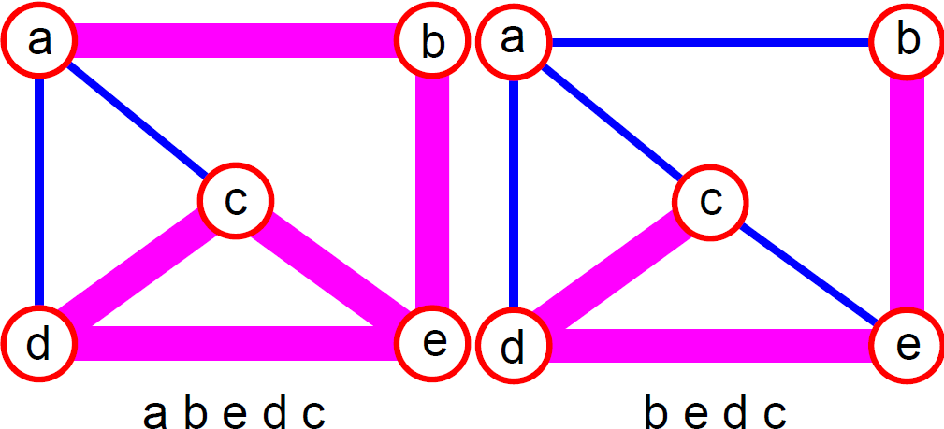
Graph Terminology
Adjacent nodes: two nodes are adjacent if they are connected by an edge.
Path: a sequence of vertices that connect two nodes in a graph.
5 is adjacent to 7
7 is adjacent from 5

Slide 13
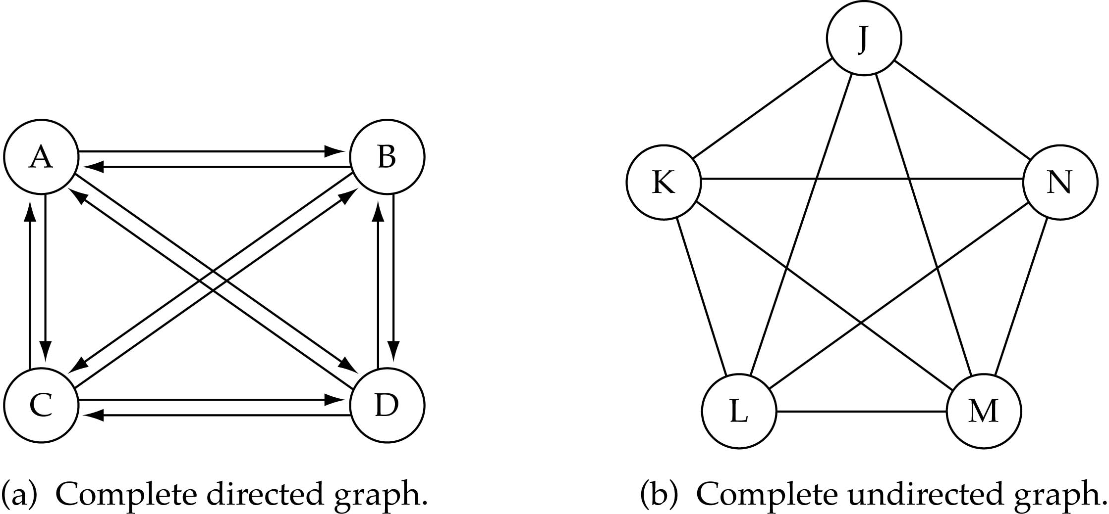
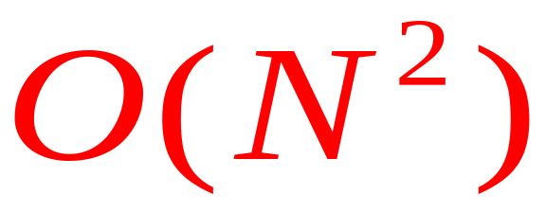
Graph Terminology (cont.)
Complete graph: a graph in which every vertex is directly connected to every other vertex.
What is the number of edges in a complete directed graph with N vertices? N * (N-1)

Slide 14
Graph Terminology (cont.)
What is the number of edges in a complete undirected graph with N vertices? N * (N-1) / 2

Slide 15
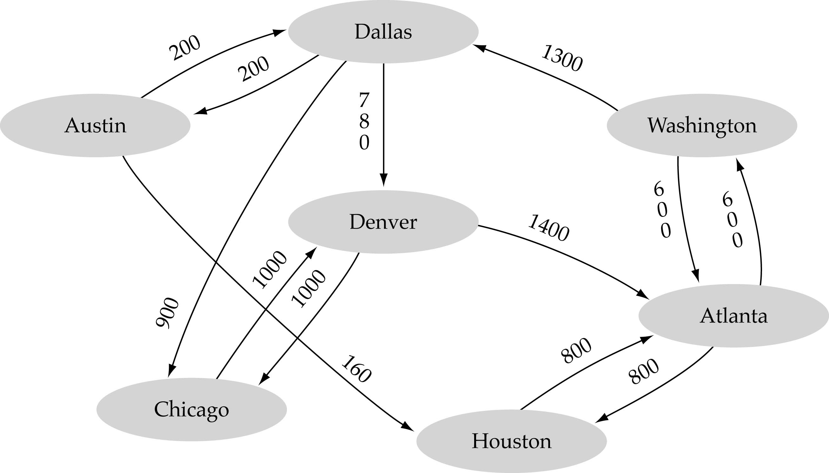
Graph Terminology (cont.)
Weighted graph: a graph in which each edge carries a value.
Airline route graph, in miles

Slide 16

Graph Implementation
Array-based Implementation
  A 1D array is used to represent the vertices.
  A 2D array (adjacency matrix) is used to represent the edges.

Slide 17
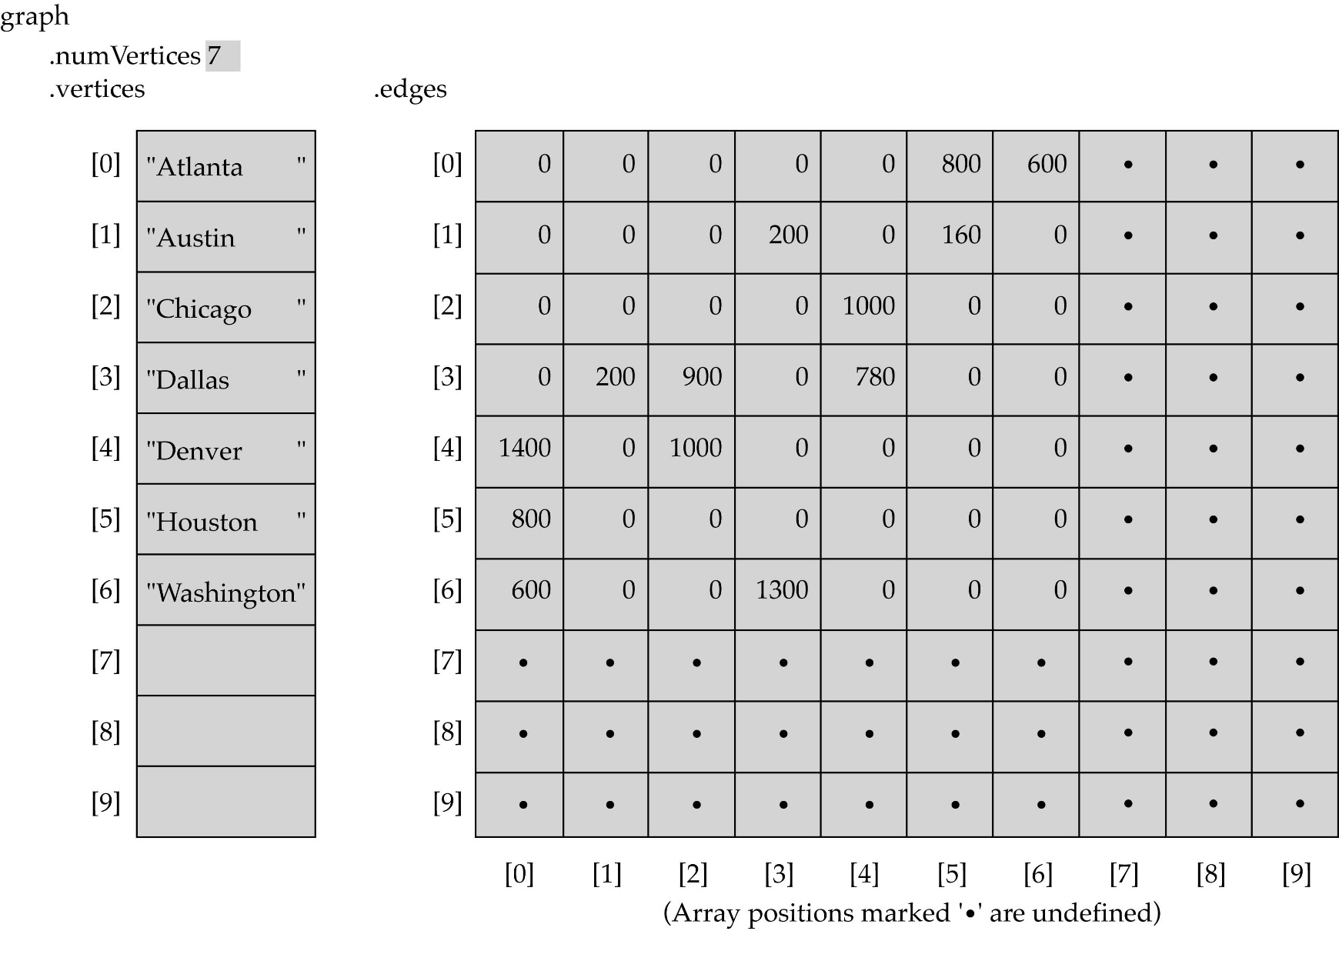
Array-based Implementation

Slide 18
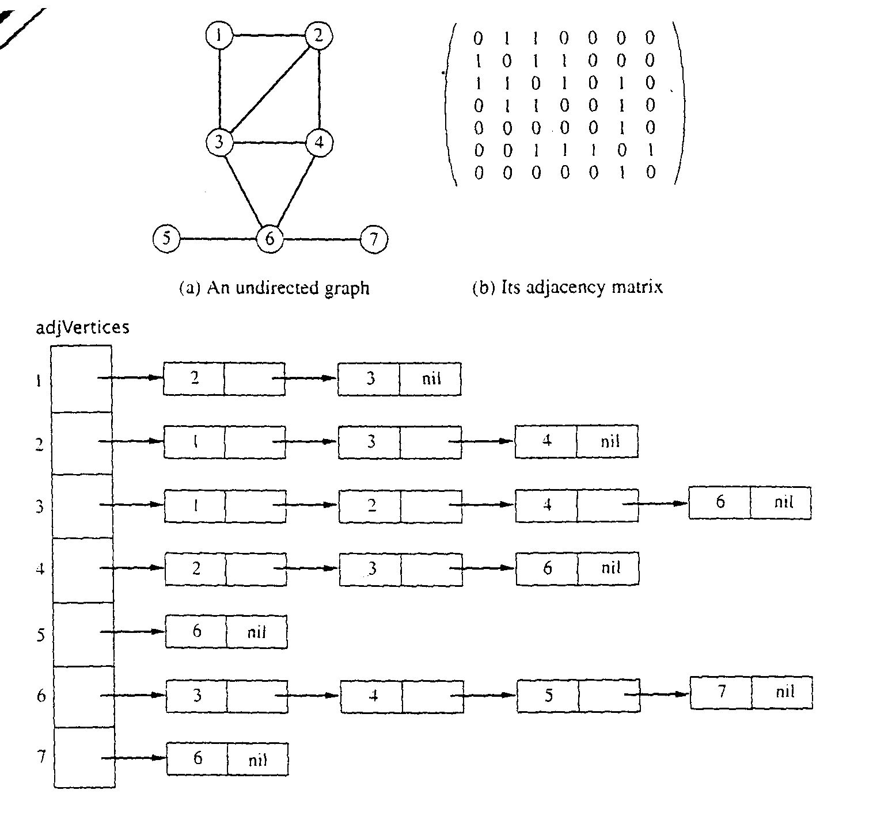
Adjacency Matrix Representation
Let G = (V,E), n = |V|, m = |E|, V = {v₁, v₂, …,v_{n})
G can be represented by an n × n matrix.
Implemented using 2D array

Slide 19
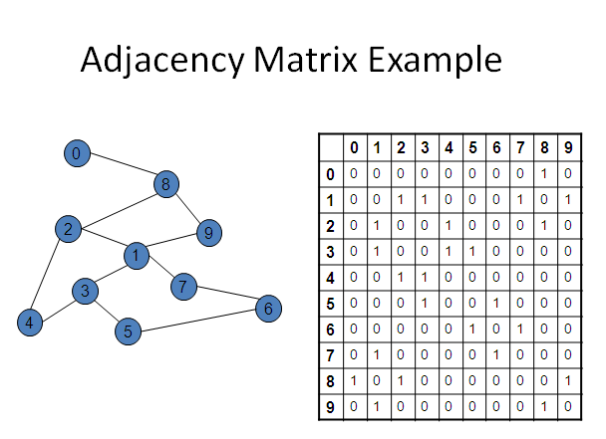
Adjacency Matrix Representation (cont.)

Slide 20
Graph Implementation (cont.)
Linked-list Implementation
  A 1D array is used to represent the vertices.
  A list is used for each vertex v which contains the vertices which are adjacent from v (adjacency list).

Slide 21
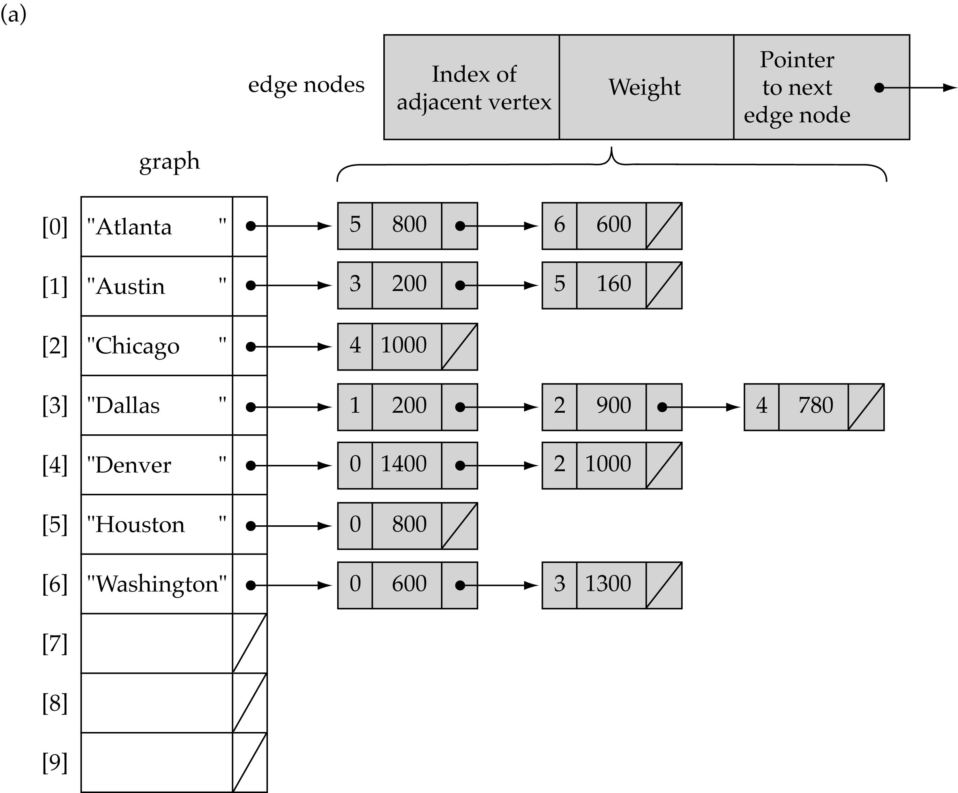
Linked-list implementation
Use a 1D array and linked lists

Slide 22
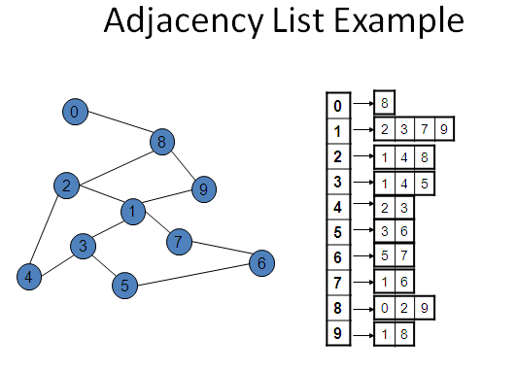
Each list A[i] stores the ids of the vertices adjacent to vertex i.

Slide 23
Adjacency Matrix vs Adjacency List Representation
Adjacency Matrix
  Good for dense graphs (more edges):|E|~O(|V|²)
  Memory requirements: O(|V| + |E| ) = O(|V|² )
  Connectivity between two vertices can be tested quickly
Adjacency List
  Good for sparse graphs(few edges) -- |E|~O(|V|)
  Memory requirements: O(|V| + |E|)=O(|V|)
  Vertices adjacent to another vertex can be found quickly

Slide 24
Graph Searching
Problem: find a path between two nodes of the graph (e.g., Austin and Washington).
Methods:
  Depth-First Search (DFS) Or
  Breadth-First Search (BFS)

Slide 25
Depth-First Search (DFS)
What is the idea behind DFS?
  Travel as far as you can down a path.
  Search deeper in the graph, when ever possible.
Given an input graph G = (V, E) and a source vertex S, from where the searching starts.
  First we visit the starting node.
  Then we travel through each node along a path, which begins at S.
  That is we visit a neighbor vertex of S and again a neighbor of a neighbor of S, and so on.
DFS can be implemented efficiently using a stack.

Slide 26
Algorithm
Input the vertices and edges of the graph G = (V, E).
Input the source vertex and assign it to the variable S.
Push the source vertex to the stack.
Repeat the steps 5 and 6 until the stack is empty & destination is found.
Pop the top element of the stack and display it.
Push the vertices which is neighbor to just popped element, if it is not in the stack displayed (i.e; not visited).
Exit.

Slide 27
Algorithm
Set found to false
Push(startVertex)
DO
Pop(vertex)
IF vertex == endVertex
Set found to true
ELSE
Push all adjacent vertices onto stack
WHILE !IsEmpty() AND !found
IF(!found)
Write "Path does not exist"

Slide 28
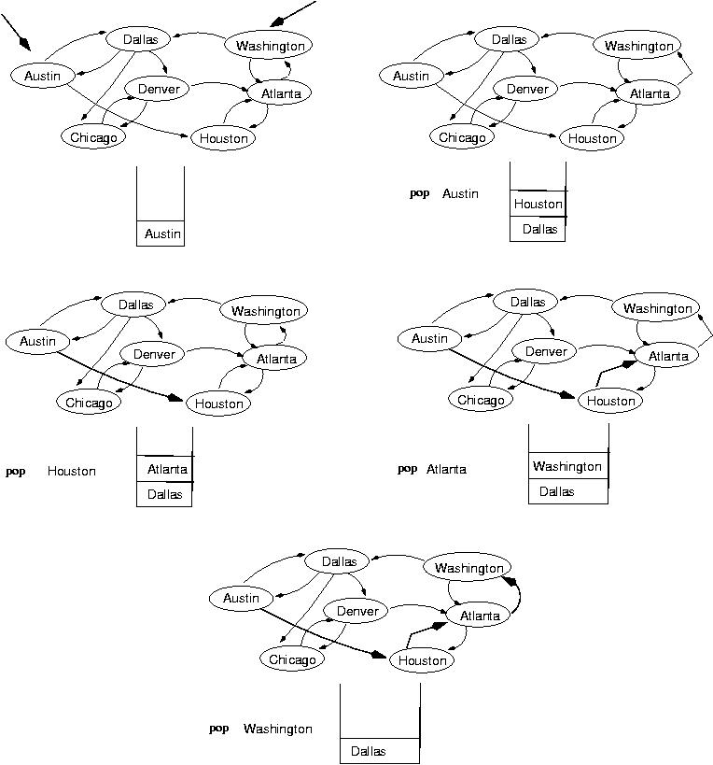
Example: Is there a path from Austin to Washington?
start
end
(initialization)

Slide 29
Example: Is there a path from Austin to Washington?...

Slide 30
Example: Is there a path from Austin to Washington?...
Found!

Slide 31
Breadth-First Search (BFS)
What is the idea behind BFS?
  Look at all possible paths at the same depth before you go at a deeper level.
  Explore every vertex that is reachable from source vertex, S.
  Examine the entire vertices neighbor to S.
  Then traverse all the neighbors of the neighbors of S and so on.
  A queue is used to keep track of the progress of traversing the neighbor nodes.
  BFS can be implemented efficiently using a queue.

Slide 32
Algorithm
  Set found to false
  enqueue(startVertex)
  DO
  dequeue(vertex)
  IF vertex == endVertex
  Set found to true
  ELSE
  Enqueue all adjacent vertices onto queue
  WHILE !IsEmpty() AND !found
IF(!found)
Write "Path does not exist"

Slide 33
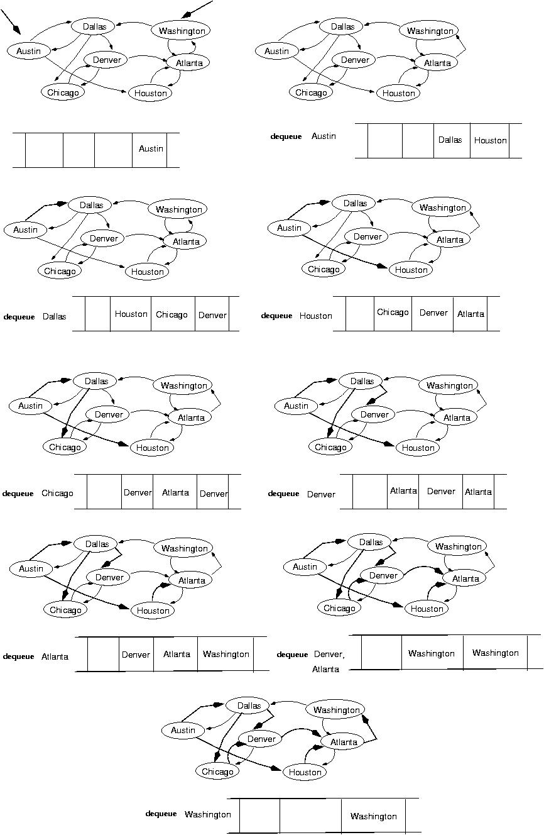
Example: Is there a path from Austin to Washington?
start
end
(initialization)

Slide 34
Example: Is there a path from Austin to Washington?...
next:

Slide 35
Example: Is there a path from Austin to Washington?
Found!

Slide 36
Reading Assignment
Minimum Spanning Tree
  Kruskal’s Algorithm
  Prim‘s Algorithm

